Slide 1

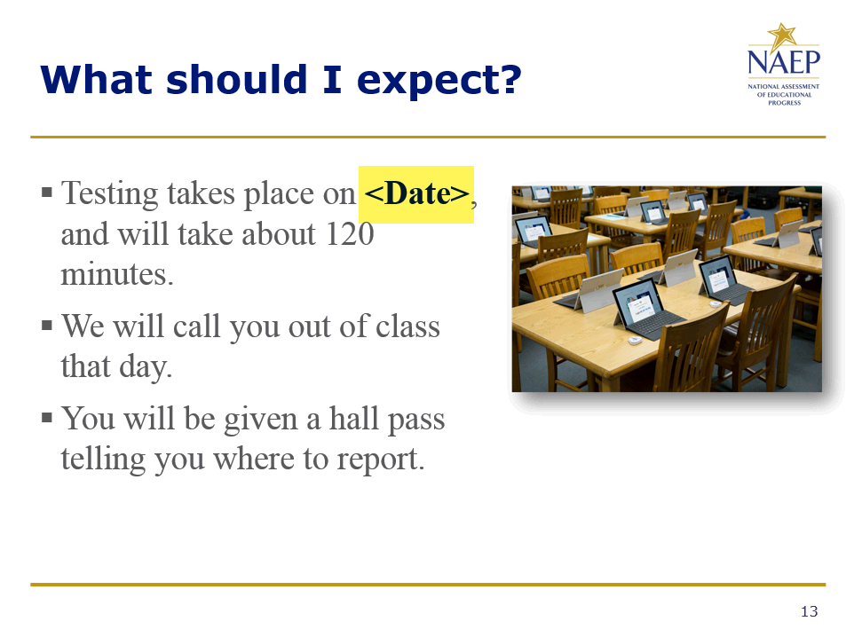
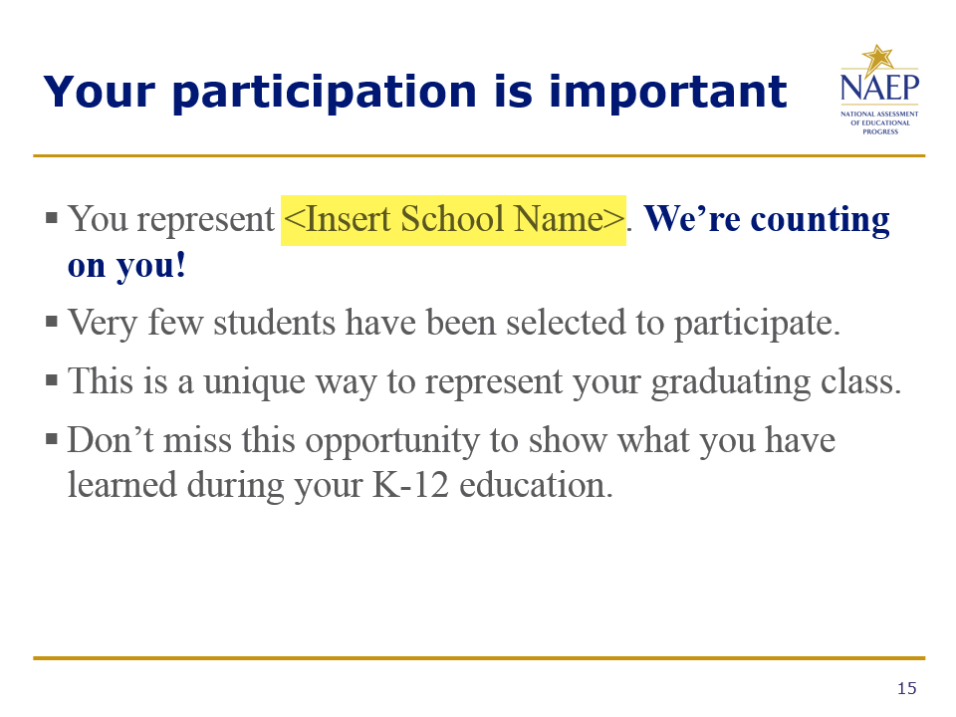
Before you use this presentation…
Insert your school name on slide #2.
Include the assessment date on slide #13.
Insert your school name on slide #15.
Delete this slide after making the above updates.
Slide #2
Slide #13
Slide #15

Slide 2

Coming soon to Hazleton Area High School!

Slide 3
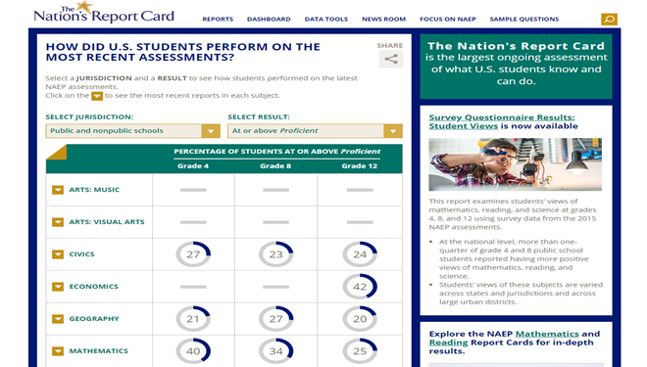
What is the Nation’s Report Card?
A program that measures student achievement in major subject areas across the nation at grades 4, 8, and 12.
It is also known as NAEP, which stands for the National Assessment of Educational Progress.
https://nationsreportcard.gov/

Slide 4
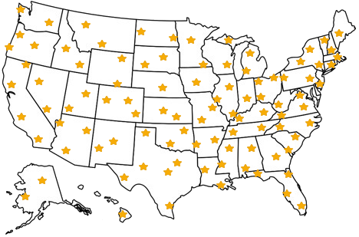
Does everyone take the NAEP test?
No! Very few high schools are selected for NAEP.
  First, schools are selected to represent other schools across the nation.
  Then, a small group of students is randomly selected.
When you participate, you represent hundreds of students like you all across the county.

Slide 5

What is included on the NAEP test?
Seniors will take a mathematics, reading, or science assessment on a tablet.
  Each student will take one subject only.
The tablets include a keyboard, stylus, and earbuds.
  You can keep the NAEP earbuds, or bring your own earbuds if you prefer.

Slide 6
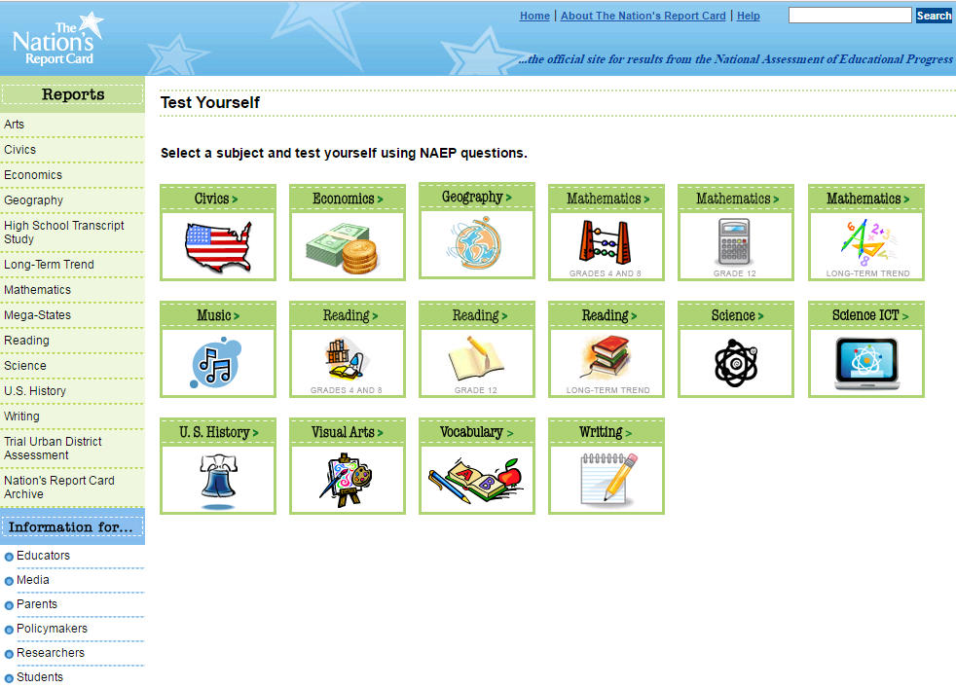
What is included on the NAEP test?
Questions are multiple-choice, short answer, or essay.
Questions about how your teachers teach, your educational experiences, and other information.
Sample questions are available online.
https://nationsreportcard.gov/testyourself.aspx

Slide 7
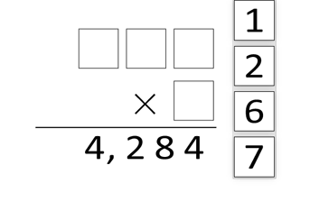
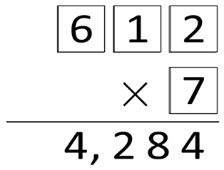
Sample Mathematics Question
Drag each of the digits 1, 2, 6, and 7 into the boxes to make the following multiplication problem correct.
Use each digit only once.
79% of students answered correctly during the 2017 assessment.
Correct Response

Slide 8
Sample Reading Excerpt
“I don't mean to put a damper on things. I just mean we ought to treat fun reverently. It is a mystery. It cannot be caught like a virus. It cannot be trapped like an animal. The god of mirth is paying us back for all those years of thinking fun was everywhere by refusing to come to our party. I don't want to blaspheme fun anymore. When fun comes in on little dancing feet, you probably won't be expecting it. In fact, I bet it comes when you're doing your duty, your job, or your work. It may even come on a Tuesday.”
FUN by Suzanne Britt Jordan
From The New York Times, used with permission.

Slide 9
Sample Reading Question
Explain what the author means when she says, "Fun is a rare jewel."
She means that fun is not something that exists everywhere in everything. Rare jewels are precious and cherished, not something found in common, everyday life. She is saying that fun is just like that, that it should be precious and savored when it becomes available.
78% of students wrote an acceptable response to this question during the 2013 assessment.

Slide 10
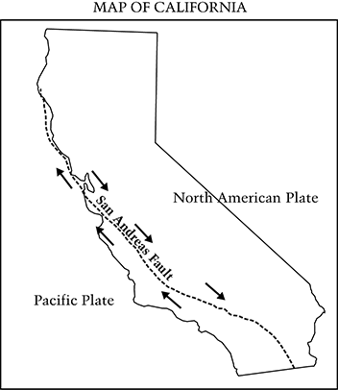
Sample Science Question
The diagram below shows the movement of the Pacific and North American plates along the San Andreas fault located in California.
A
One plate slowly pushes the other plate up.
B
A trench is created as one plate slides under the other plate.
Portions of the plates get stuck and then suddenly loosen and move.
C
D
One plate pushes hard enough to reverse the motion of the other plate.
25% of students selected C, the correct answer to this question during the 2011 assessment.
Why do earthquakes occur near the San Andreas fault?

Slide 11
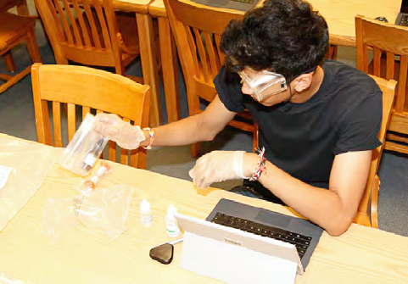
Hands-on Science Tasks
Students selected for the science assessment will use a kit to perform experiments, and will use tablets to enter their observations.

Slide 12
How should I prepare for NAEP?
Good news! You don’t have to study.
You can skip any questions on the test, we just ask that you try your best to answer each question.
Your scores will be anonymous, and will not affect your grades or academic record in any way.
Your scores will be combined with other students’ scores to show what seniors know about the subject areas across the nation.

Slide 13
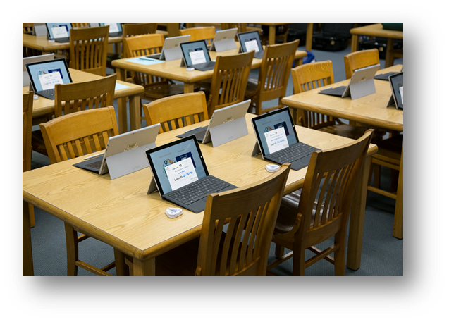
What should I expect?
Testing takes place on February 26,2019, and will take about 120 minutes.
We will call you out of class that day.
You will be given a hall pass telling you where to report.

Slide 14

NAEP is important
NAEP is the only national measure of what students know and can do in a variety of subjects.
Important decisions about education are made using NAEP results.
We want you to do your best because you represent seniors all across the United States.
You can contribute to improving the quality of education for all students in the United States.

Slide 15
Your participation is important
You represent Hazleton Area High School. We’re counting on you!
Very few students have been selected to participate.
This is a unique way to represent your graduating class.
Don’t miss this opportunity to show what you have learned during your K-12 education.

Slide 16



Find out more
Visit NAEP: http://nces.ed.gov/nationsreportcard/students
Follow NAEP:

Slide 17
A word from your peers!
Here’s a quick video made just for students...

